Slide 1
Jenkins Deployment to Tomcat Server

Slide 2
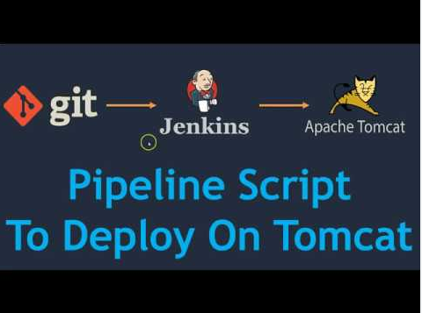

Slide 3
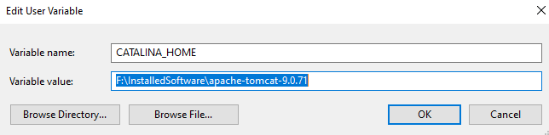
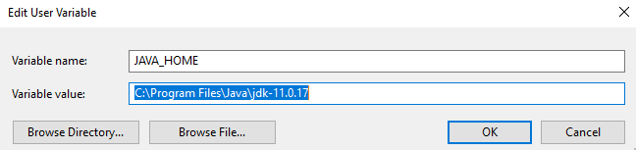
Environment Configuration
Got to $CATALINA_HOME/conf directory and look for tomcat-users.xml file.

Slide 4

Update Roles and User credentials - Configuring Tomcat Security

Slide 5
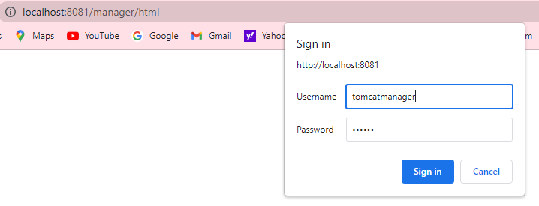
Manager GUI

Slide 6
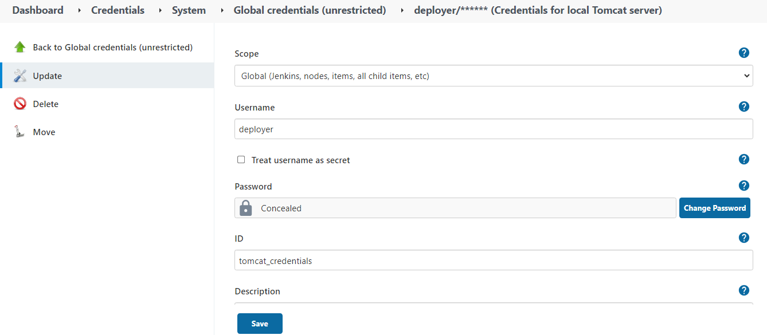
Manage Jenkins -> Manage Credentials ->Global Credential -> Add Credentials

Slide 7
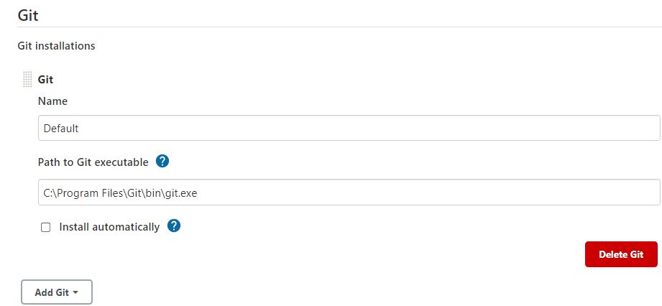
Jenkins Configuration
In Jenkins UI, Goto Manage Jenkins -> Global Tool Configuration Section of Jenkins

Slide 8
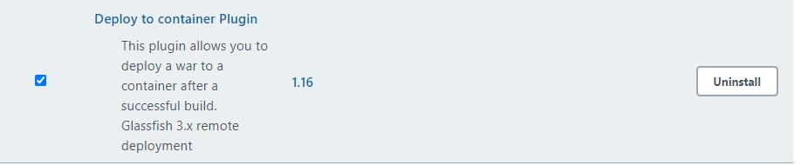
Install Deploy to Container Plugin
Manage Jenkins -> Manage Plugins -> Available -> Deploy to Container Plugin

Slide 9

Demo
Jenkins Deployment to Tomcat Server

